Slide 1

REACH OUT
RAECH OUT
THE PIONEERS

Slide 2
HELP PUT A SMILE ON EVERY CHILD’S FACE
LEND A HELPING HAND.
A CEDI CAN CHANGE A CHILD’S LIFE

Slide 3

A HAND THAT GIVES IS A HAND THAT NEVER LACKS

Slide 4
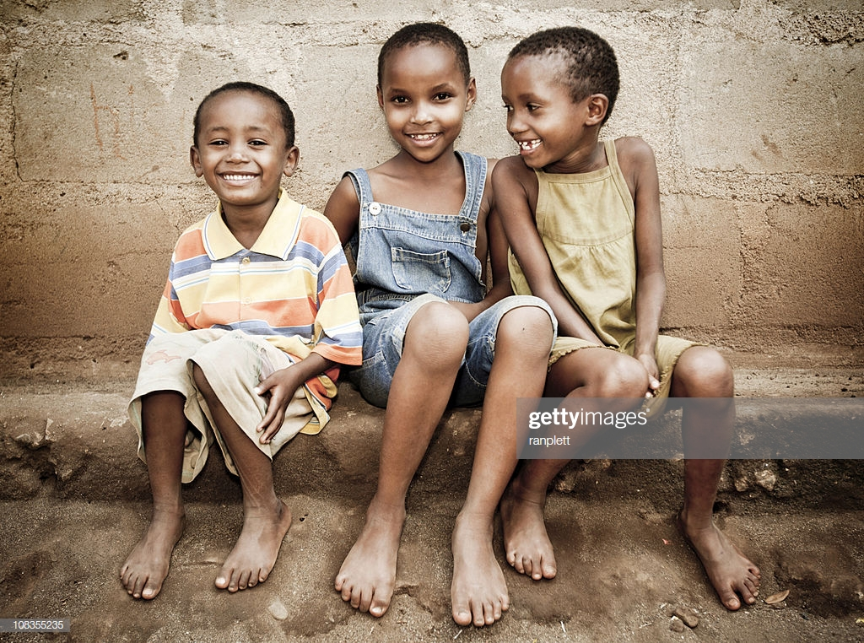
EVERY PENNY COUNTS
LETS REACH OUT FOR A BETTER WORLD

Slide 5
PROBLEMS
REACH OUT
Poor tuition and food
Streetism
Social vices
Shelter
Distance
Security
Utilities

Slide 6
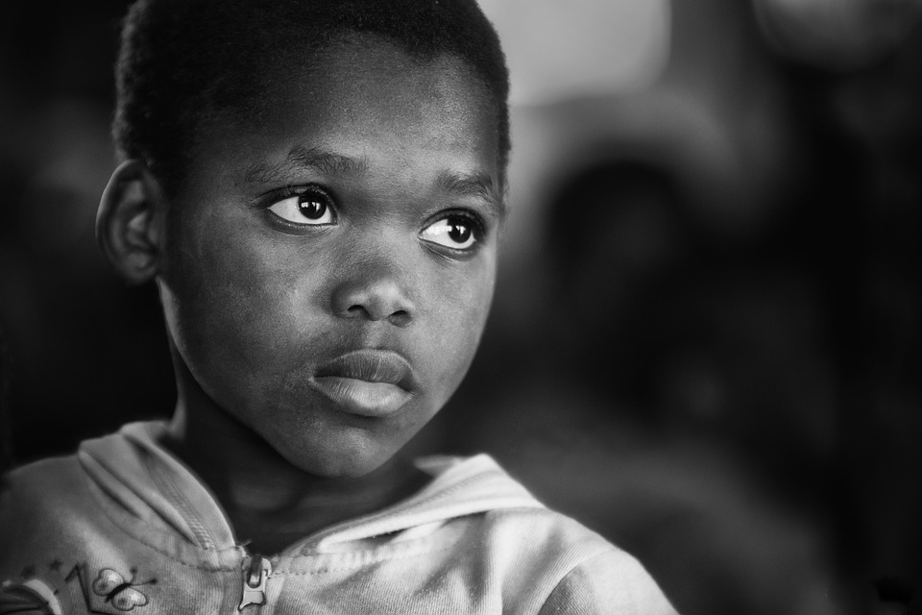

Slide 7
OUR SOLUTION
REACH OUT
Here at REACH OUT our main objective is to help the needy mainly orphans
REACH OUT is a home and safe haven for children who have been marginalized by a broken society. Here at REACH OUT we hope to give these children a second chance in life by investing directly into their lives, treating them as individuals, and raising them to be young adults who achieve their God-given potential
Donation
Sponsoring a child is a profound way of impacting a child’s life. By supporting a child financially, you are meeting their basic needs now and are making an investment in their future. If you are interested in sponsoring a child please contact us.
Fast and easy donation
.

Slide 8


Slide 9


Slide 10


Slide 11
How it Works
REACH OUT
Online Donation
Volunteer

Slide 12
THE PIONEERS
Idris Owolabi Aliu (CRO)
Osman Iddrisu
(PRO)
Siibu Mukadas (CFO)
Mohammed Abdul Haque
(CTO)
Henkel Yussif
(CEO)
Abdul Kahar Abdul Rahman (COO)

Slide 13
Live Demo

